Slide 1
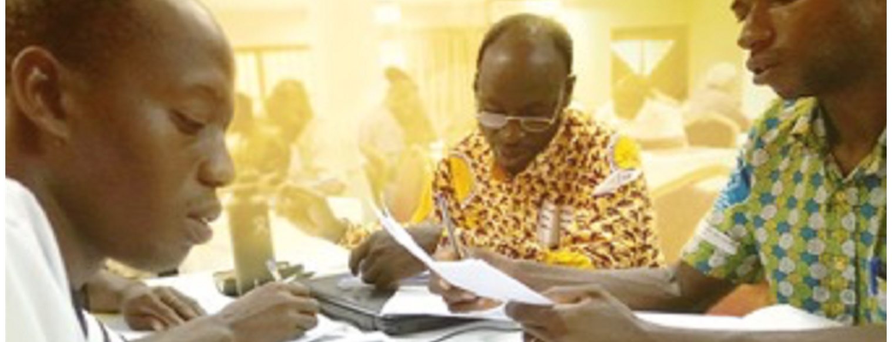
Do not withhold good from those to whom it is due, when it is in the power of your hand to do so. Do not say to your neighbor, “Go, and come back, and tomorrow I will give it,” when you have it with you (Prov. 3:27-28).
All Scripture is taken from the New King James Version®. © 1982 by Thomas Nelson, Inc. Used by permission. All rights reserved.
Release Early,
Revise Often

Slide 2
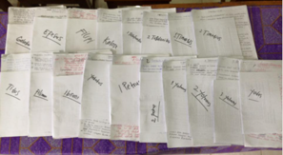
?
When should a translation be shared with the language community?
When the translators have made it
the best they can
at the time

Slide 3
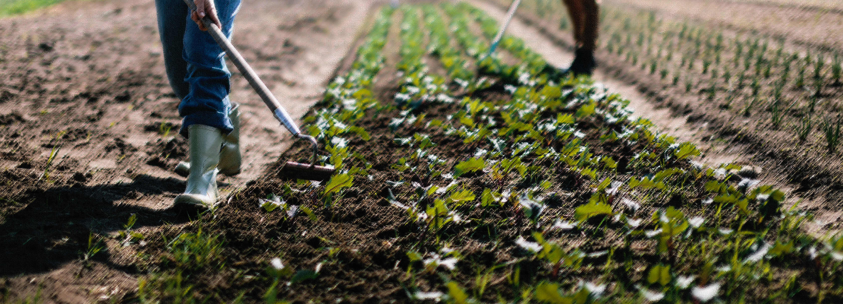
Ecclesiastes 11:2, 4
Give a serving to seven, and also to eight, For you do not know what evil will be on the earth.
⁴ He who observes the wind will not sow, And he who regards the clouds will not reap.

Slide 4
?

Slide 5
Feedback
Corrections
Improvements
Updates

Slide 6

?
What could happen
if the team does not release early?
Language changes

